Slide 1


Coffee sales report

Slide 2
AGENDA
INTRODUCTION.
TOTAL SALES FOR EACH TYPE OF COFFEE IN MONTH.
PAYMENT MODE WISE SALE OF COFFEE.
MONTH WISE SALE OF EACH COFFEE.
TOTAL MONTHLY SALES.
MONTHLY CASH TRANSACTION.

Slide 3
INTRODUCTION
The motive of this report is to provide a detailed analysis of coffee sales.
It include the popularity of different beverages, payment ,mode and sales trends over a months.
This report would be useful for a coffee shop or business to understand their sales performance.

Slide 4
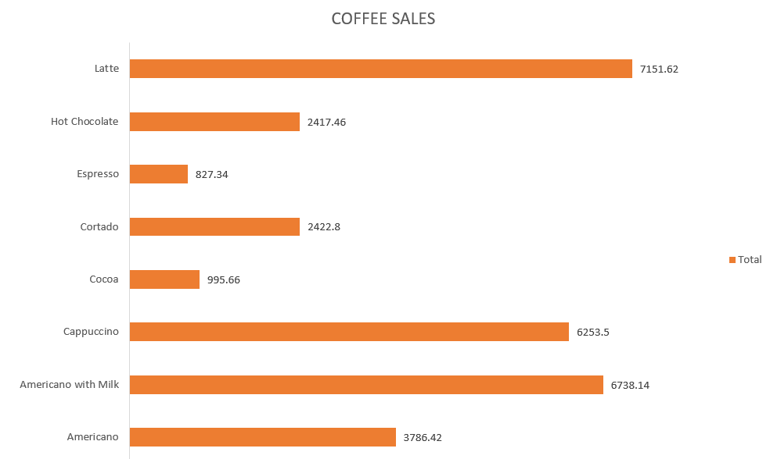
TOTAL SALES FOR EACH TYPE OF COFFEE IN MONTH.
presents an overview of the total sales for each type of coffee beverage.
The lowest sales of coffee is espresso at only 827.34 in all months.
This chart indicate that Latte sales being the highests sales at 7151.62.

Slide 5
PAYMENT MODE WISE SALE OF COFFEE.
This pie chart provide a breakdown of the sales by payment mode.
This chart suggest a strong preference for card payments among the customers.

Slide 6
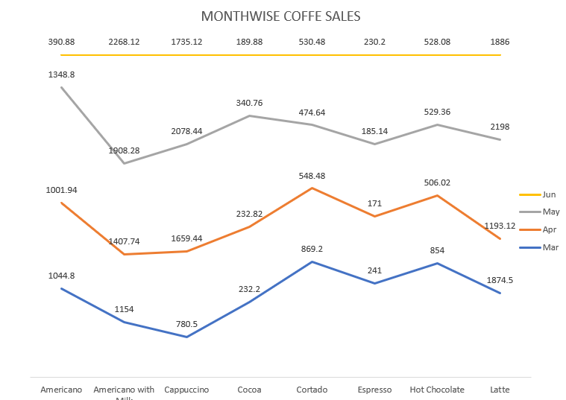
MONTH WISE SALE OF EACH COFFEE.
This line chart provide month-wise sales of each coffee beverage.
Data shows the fluctuation in sales across the months.

Slide 7
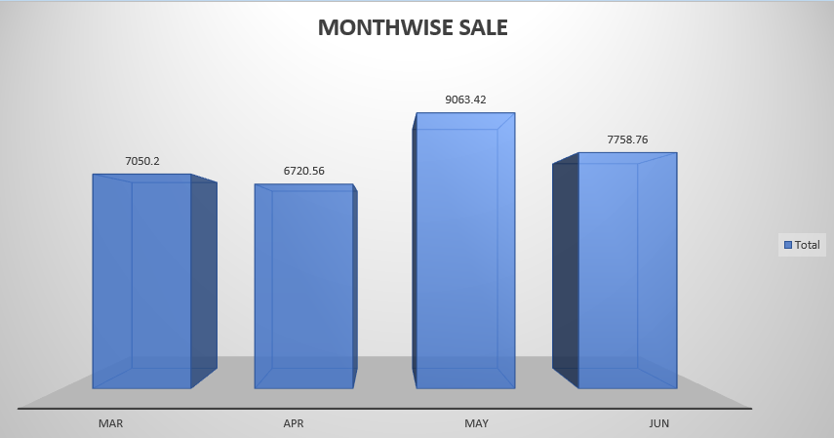
TOTAL MONTHLY SALES.
This chart summarize the total sales on a month.
The highest sales recorded in June.
The lowest sales recorded in April.

Slide 8
MONTHLY CASH TRANSACTION.
This chart conclude the count of cash transaction in each month.
This shows that the highest number of cash transaction occurred in June and lowest in april.

Slide 9
CONCLUSION
The report conclude that, the coffee sales report serves as valuable tool for understanding the performance of the coffee business, customer preference and payment trends.

